Slide 1
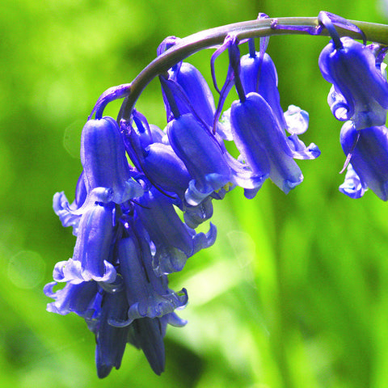
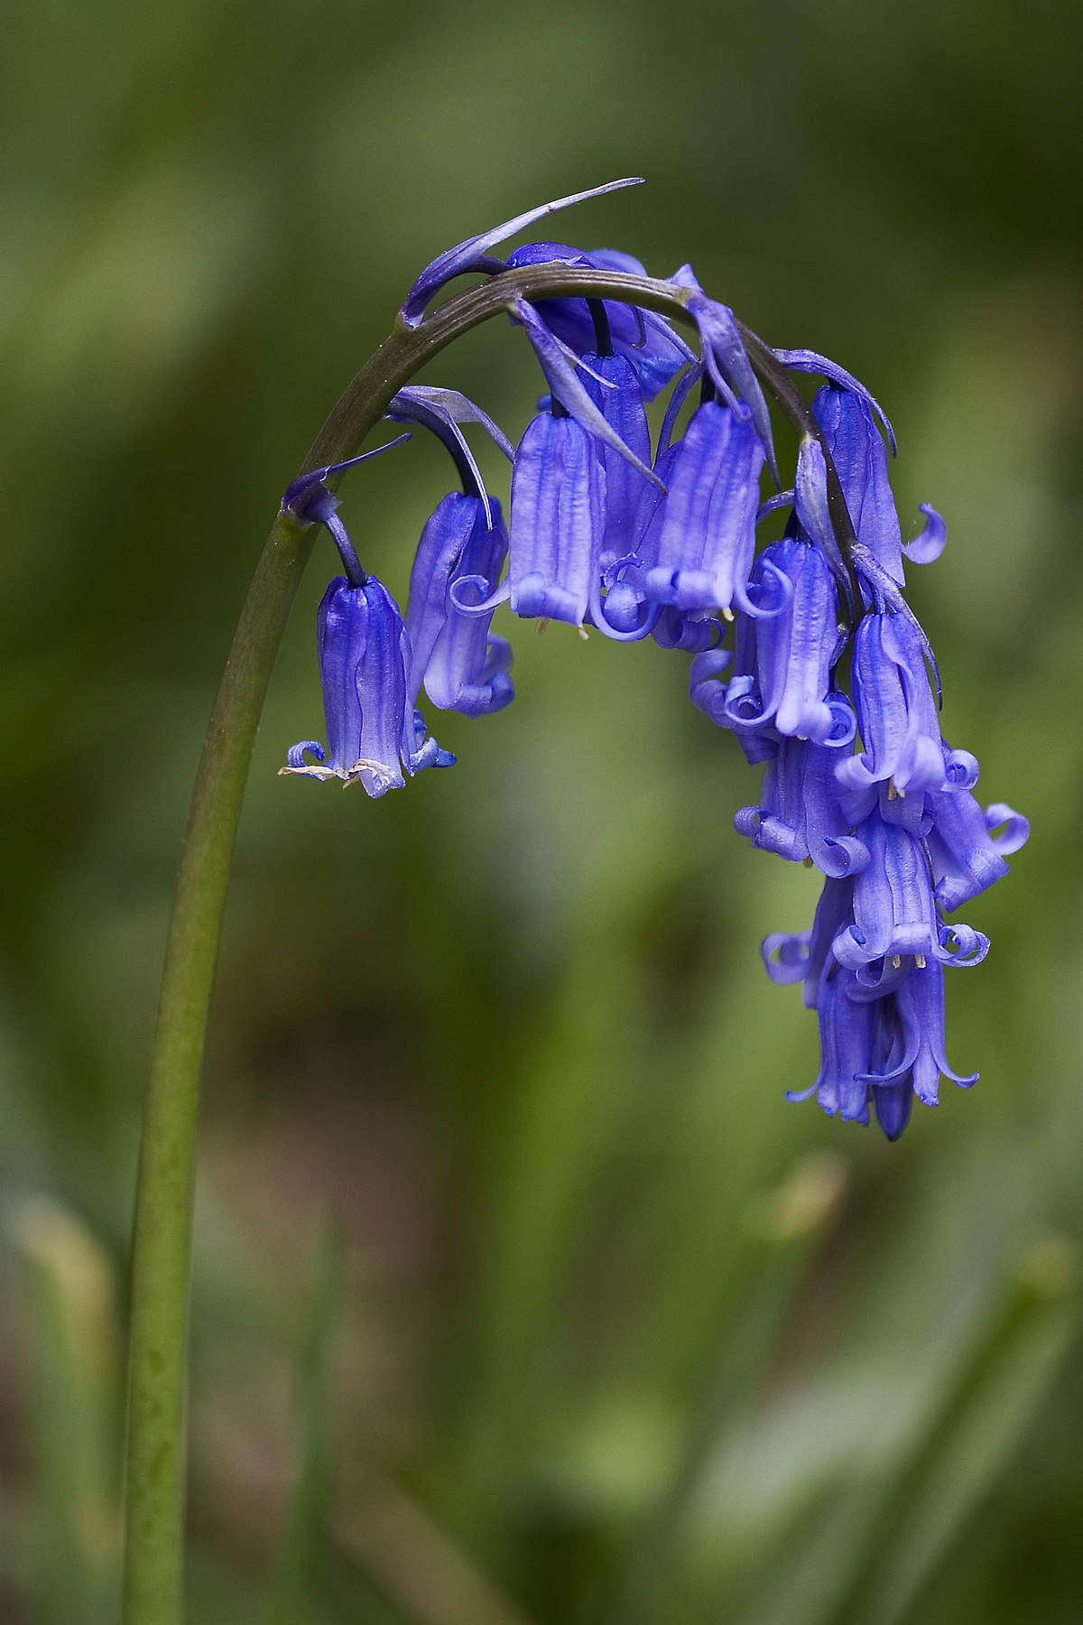
Welcome to Bluebells Class!
Class Teacher: Mrs Manson
TA: Mrs McCaffery, Mrs Polkinghorne, Ms De Frond and Mrs Reed.

Slide 2
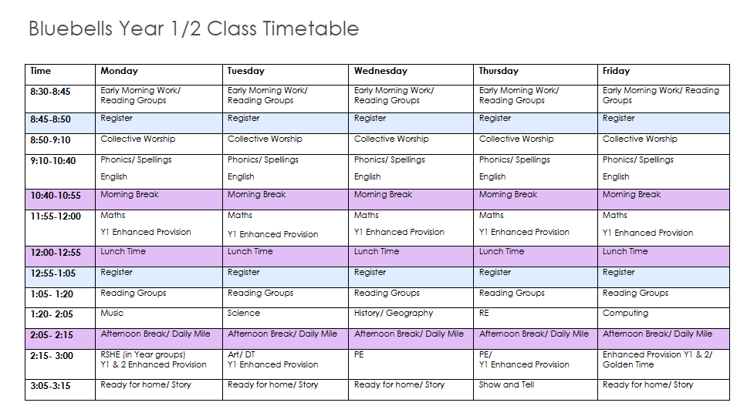
A normal day in Bluebells:
Our PE days are Wednesday and Thursday.

Slide 3
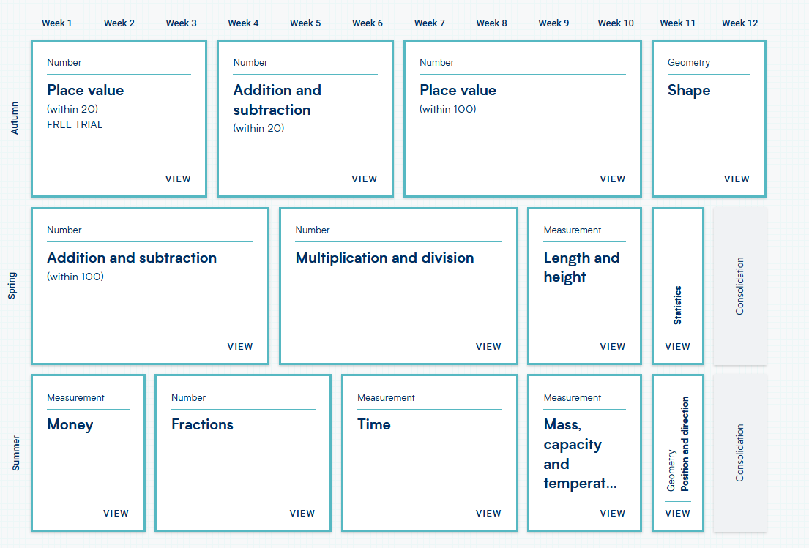
Our Maths Long Plan:
We now teach maths as a whole class. This means that Year 1 and Year 2 children will have the same teacher lead learning. However, they will have different independent activities to complete.
The Year 1 children will also have 'Enhanced Provision' opportunities throughout the day which will further embed their maths learning from each lesson.

Slide 4
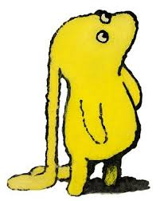
English and Reading:
Throughout the year we will be focusing on a wide variety of high-quality fiction and nonfiction texts.
Autumn 1: How to Babysit Grandad by Jean Reagan/ The Last Wolf by Mini Grey
Autumn 2: Orion and The Dark by Emma Yarlett/ The Emperor's Egg by Martin Jenkins
Spring 1: Beegu by Alexis Deacon/ Bob Man on the Moon by Simon Bartram
Spring 2: The Storm Whale by Benji Davies
Summer 1: Claude in the City by Alex T Smith/ Nonfiction Texts
Summer 2: One Night Far Away by Julia Wauters/ The Lonely Beast by Christ Judge
We will be writing a range of genres over the year, including (but not limited to): letters, recounts, non-chronological reports, poetry, diaries, and leaflets.

Slide 5

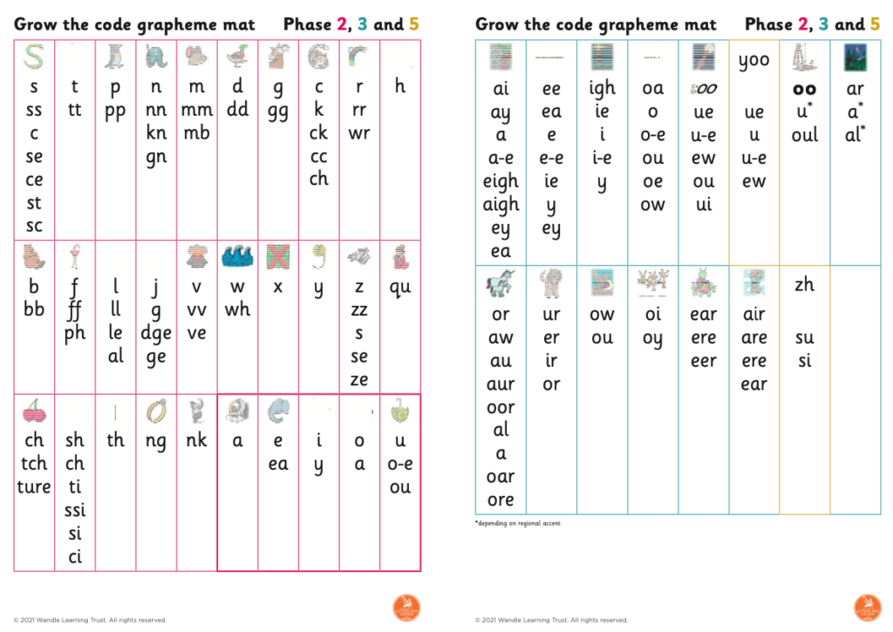
English and Reading:
We use Little Wandle for our Phonics teaching.
We will continue to do our 3x weekly reading sessions with the children using the Little Wandle reading books.
When the children are ready to, they will be invited to take the Accelerated Reader Quiz. This quiz provides a reading age for the child, shown as a colour, and the children can then choose an additional reading book to take home.
Please note, that this does not replace the Little Wandle books, and they will still partake in the weekly reading sessions.

Slide 6
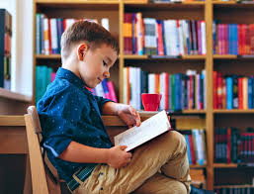
English and Reading:
Please bring in reading folders every day. Please ensure that their Reading Records are in the Reading Folders even if you have not had time to read or practise phonemes with them at home. ​
We will soon launch our annual reading army. They spend any morning they can spare between 8.30-8.50, hearing members of the class practise their phonemes and sight words. ​
If you can help, please offer! 4 adults can get through all 20 children in less than 20 minutes!​

Slide 7

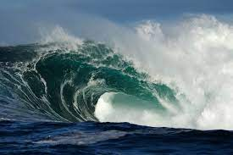
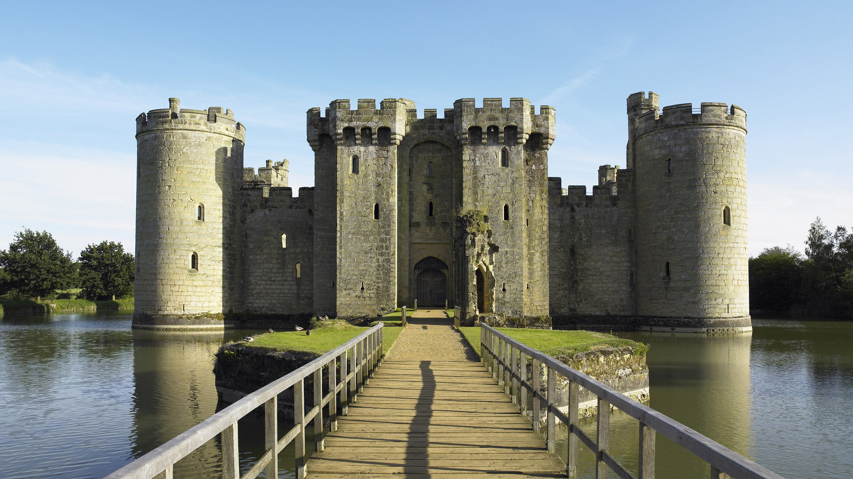
History and Geography:
Our History and Geography topics for this year are:
Term 1- Castles
Term 2- Local Area Study
Term 3- Moon Landings
Term 4 Continents and Oceans
Term 5- Great Fire of London
Term 6- Deserts

Slide 8
Other Subjects:
The children are taught the National Curriculum.
https://www.gov.uk/government/publications/national-curriculum-in-england-primary-curriculum
This includes:
English
Maths
Phonics
Science
RE
History
Geography
PE
Art/ DT
Music
Computing
RSHE
PE

Slide 9
Online safety
At the start of every year, as a team, we reflect on any matters which arise and feel need supporting.
Online safety and the activity our children get up to when using the internet is an area which has a lot of press/ media interest.

Slide 10
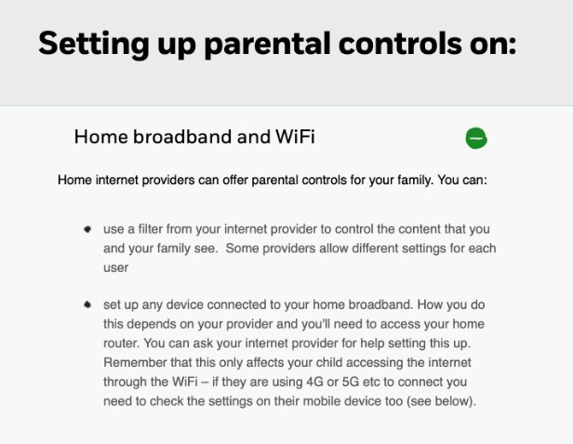
Online safety
Ensure that if your child has access to a device such as an Amazon Fire or an i-Pad that there are appropriate parental controls turned on

Slide 11
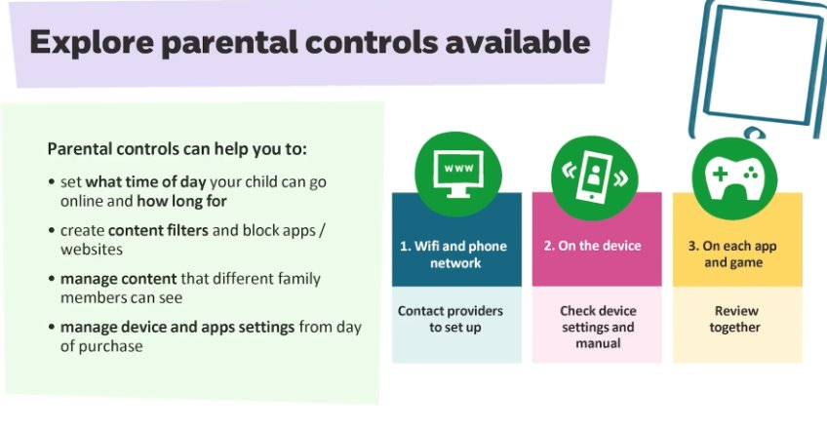
Online safety
Remember – parental controls and safety need to be set up on the WiFi as well as each device. ​
The moment that a device comes off the WiFi and uses 4G, then parental restrictions and controls are removed. So, take care!

Slide 12
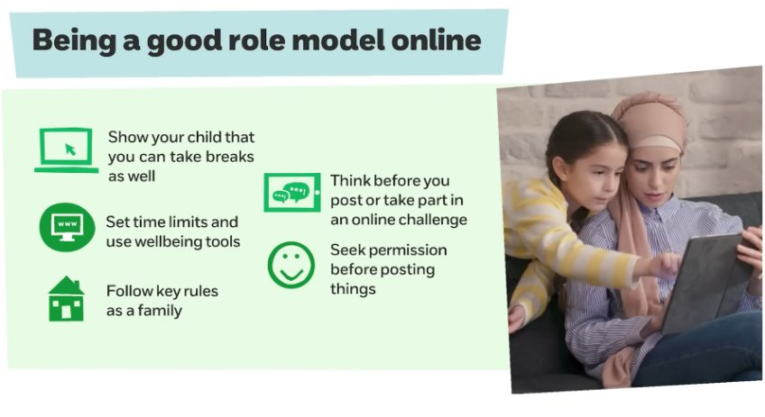
If there are any questions or you need any help, advice or support then please do contact school.

Slide 13

Homework:
Year 1 and Year 2 will both receive homework in line with our homework policy.
Year 1- 1 hour per week
Reading to a child. Sharing a wide range of books. Hearing a child read a book as directed by the class teacher x3 per week minimum. Spelling and/or phoneme recognition practice. 5 Other occasional single project tasks.
Year 2- 1.5 hours per week
Reading to a child. Sharing a wide range of books. Hearing a child read a book as directed by the class teacher x3 per week minimum. Spelling Practice and/or Times Tables (from Spring 1) Maths or English homework based on what the children have been learning in class during the week. Other occasional single project tasks.

Slide 14
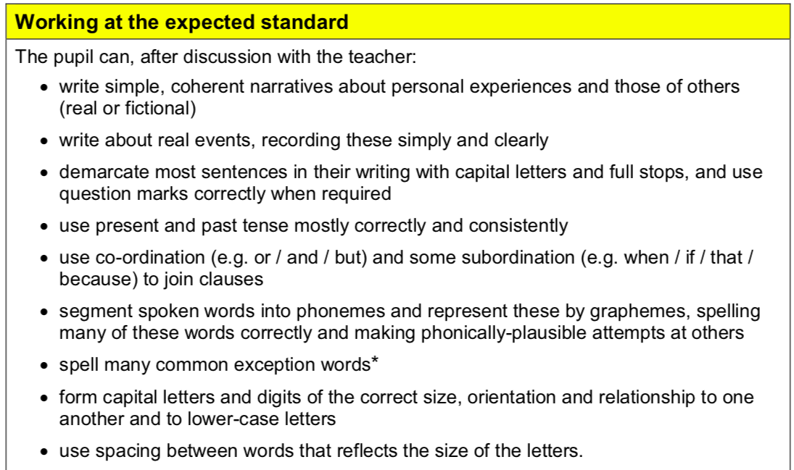
SATs and Assessments:
SATs take place over a week in May and are absolutely nothing to be worried about. The children will sit them in very small groups with a teacher or teaching assistant.
SATs papers the children will take:
Spelling
GPS
Reading 1
Reading 2
Maths Arithmetic
Maths Reasoning
Writing is not assessed by a paper, but rather a collection of their work from April- June. The children must meet all criteria consistently in the category to be awarded that grade. E.g. A child must meet all EXS and GDS to be awarded GDS.
There will be a meeting around February to give you more information about the optional SATs.
*Phonics resits will take place during the first week of June.

Slide 15
Forest School:
Forest School takes for a term, once a year, ours is in Term 4.
The children will need:
A long sleeved top
Long trousers
A waterproof coat
Welly boots
A water bottle
Thick socks
The might need:
Sun cream
Sun hat
Winter hat/ ear muffs
Gloves
Waterproof trousers
The children go to forest school in all weathers so they need to be prepared for it!

Slide 16
General Information:
Please name every item of clothing that comes into school. If it then gets lost it will be easily reunited with your child!
Snacks at break times should be fruit only. The children have access to a range of free fresh fruit and vegetables that are delivered twice a week.
Bottles should only have water in unless agreed otherwise.
There is milk available for children to have at break times daily. If you wish for your child to have fresh milk, please ask at the school office.
Show and Tell is on Thursday afternoons. Please do not send anything into the class, instead take a picture of it and upload it to seesaw! I can put the images on the whiteboard and it prevents the item/s from getting lost. It is a perfect opportunity to share the places you have visited or achievements outside of school.

Slide 17

Communication:
Our aim is for you child to reach their full potential.
We want them to feel inspired to learn and love doing so.
We want them to feel safe and happy.
If you or your child have any worries, please see me on the playground after school, make an appointment through the office, or email me at: smanson@crockhamhill.kent.sch.uk
I will respond as soon as possible.
Alternatively, check the school website. There's lots of information being uploaded and updated there. You can find all the planning there!

